Slide 1


Slide 2







Incubaid is the first and only pure cloud incubation centre with a proven track record of helping to create successful businesses.
Culmination of 15 years of experience
Exits & Expertise
Active Companies
Qlayer (2005) -> SUN (2009) Public Cloud Automation Software
VirtualBox -> SUN (2008) Most Used Open Source Hypervisor
Datacenter Technologies -> Symantec First de-duplication technology for backup
Hostbasket (2000) -> Telenet Scalable Automated Hosting for SME
Dedigate (2000) -> Terremark = Terremark cloud division Now part of Verizon
PSINet (1996) Our team build first European DC’s & Hosting
Awingu (2010) Enterprise IT Broker. Virtual Cloud Desktops, Secure Access, Data Sharing
Amplidata (2008) Fastest & most scalable erasure coding storage system in the world
Racktivity (2009) Energy and uptime management for DC
CloudFounders (2006) Hyper Converged Infrastructure & Open-source grid storage router for Virtual Machines.
Open vSolutions (2013) Next gen integrator around cloud tech
Mothership¹ (2013)
Complete cloud stack able to compete with Amazon, Rackspace

Slide 3
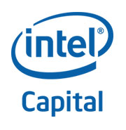










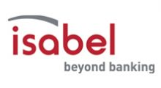






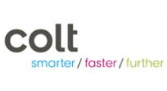
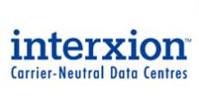






Some Incubaid Group Investors & Customers

Slide 4

Do You Like Painkillers?
We don’t, we find & resolve the root cause of problems, also in IT.

Slide 5
“0-Complexity” Summary
Intro
Clouds are complex & expensive.
Technology
Our technology is a storage & management virtualization layer which can live on top of any cloud or server and underneath +90% of apps & OS’es.
Main benefits
At least 10x cost savings on cloud
At least 10x easier to use
How
10+ years of research
Virtualization layer for storage, management & network.
Status
500k USD rev in 2014
Looking For Funding
2 – 2,5m EUR

Slide 6
Looking for cloud capacity?
Requirements
No CAPEX (no investments).
Up and running in weeks.
Multiple datacenters.
Ready for success.
Scalable (can grow when needed)
Ability to reduce capacity
What are your options?

Slide 7
Customers choice
Virtual Machines
In Clouds Like
Amazon, Google, MS, …
Dedicated Servers
With Volume Hosters
Ultra Flexible.
Reliable.
Automation is possible.
Cloud Brokerage (new).
Up and running in hours
Large Capacity
Very Expensive
Non Transparent
Often Slow
Most cost effective (1/10).
Large Capacity
Need to do all yourself.
Need experts.
No build in automation.
+- impossible to make redundant.
Large network based storage impossible.
Not flexible.

Slide 8
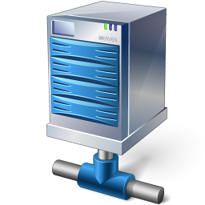

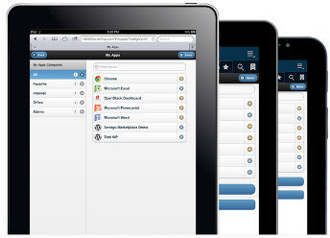
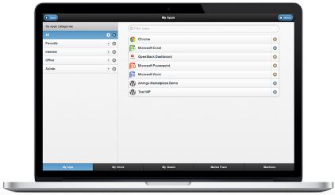
Our “0-complexity” Solution
3 Technical Problem Area’s Resolved
Desktops
Machines
Cloud
Apps
Performance
New APP/OS in 30 seconds.
+20.000 IOPS per instance
Security/Reliability
All 100% redundant
All 100% private
VPN
Auto Backup & DR
Not dependent on 1 supplier
TCO
Cost 1/10 Google
Most Easy To Use
Brokerage over clouds
Auto Scale
Any Cloud Market Place / Any Customer Facing Portal
0-Network + 0-Storage Virtualization Layer
Any Cloud
Compute
Capacity
Any Cloud Storage
Capacity
Any
Dedicated
Server

Slide 9

Our “0-complexity” Solution
!solution.create type=erp.odoo
nrusers=10
3 Components Make It Happen
ERP APP 10 users
100% redundant
Auto scale
Hyper Scalable
!solution.create type=db.postgresql
sizegb=20
performance=high
1
Fast Database
100% redundant
Auto scale
Hyper Scalable
CloudRobot
2
Virtual 0-Network Layer (100% private, on top of IPv6)
3
Virtual 0-Storage Layer (eliminate SAN, local HD, NAS, …)
Dedicated Server 1 in DC BE
Dedicated Server 2 in DC UK
Dedicated Server 3 in DC DE
Additional
Capacity For Peaks In Other Cloud

Slide 10







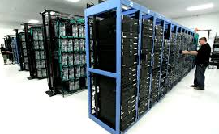
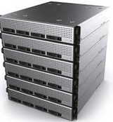
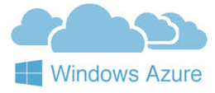




0-complexity complements / Improves !!!
Any Hosting Provisioning Tool
Any portal/website
mail
chat
O-complexity
!solution.create type=erp.odoo
nrusers=10
ERP APP 10 users
100% redundant
Auto scale
Hyper Scalable
!solution.create type=db.postgresql
sizegb=20
performance=high
Fast Database
100% redundant
Auto scale
Hyper Scalable
Virtual 0-Network & Storage Layer
Any Server Private Or Public

Slide 11
Customer Choice: example 60 machines
Google/Amazon
60 machines
2 GB mem per machine
40 GB SSD storage
Backup
Monthly cost
Google: 4.200 USD/month
Microsoft: 7.400 USD/month
Amazon: 4.600 USD/month
EXTRA TO BE PAID: Bandwidth (expensive)
Features Missing
Privacy
Reliable Performance
Clustering
0-Complexity on top of Hetzner & OVH
60 machines
On top of 4 physical servers
Monthly cost
Hetzner: 130 USD/month
OVH: 100 USD/month
0-Complexity: 270 USD/month ???
TOTAL = 500 USD
Bandwidth included
Features extra
More IOPS = more performance.
More security / privacy
Guaranteed Performance
More capacity (double memory & compute capacity as compare to others …)
More automation / easier to use

Slide 12
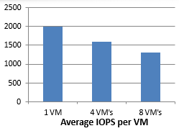


Storage is still problem nr 1 for any cloud.
NAS / SAN
Requires specific network infrastructure (10 gbit, …)
Local SSD Storage
Expensive to use as only storage medium
Hard to scale & make reliable
Is not networked (live migration?)
Management Issues:
Always random IO
Performance drops as VMs added to the same storage pool
Limited IO control
Vendor specific tools limited to the storage pool:
replication, snapshotting, acceleration, dedupe, thin provisioning, thin cloning, etc.
Virtual disk based tools don’t perform or unusable
Storage pools always attached to specific storage hardware
Replication is only typically possible between same vendors
Proprietary virtual disk formats that limit mobility
Impossible to move workloads or failover easily/quickly between different hypervisors
Performance loss while rebuilding RAID
VM
VM
VM
VM
VMDK
VMDK
VHD
VHD
Storage pool
Storage pool
SAN/NAS
Raid
Protection
12

Slide 13
Our “0-storage” virtualization layer helps.
NAS
SAN
distributed
FS
Our Solution = “0-storage”
Eliminate almost all storage & network requirements.
Only a small SSD per hypervisor is required.
“0-storage” Advantages
Immediate boot with minimal data movement.
1/10 less disks or ssd required.
No specific network required (no 10 gbit, no FC, no fast SAN, …)
Ultra reliable & fast.

Slide 14
“0-storage”: no local storage required, no SAN, no NAS
Container
Or
Virtual Machine
Container
Or
Virtual Machine
Container
Or
Virtual Machine
Physical Machine
0-storage VFS
0-storage VFS
SSD
MD
SSD
100% cache
MD
Metadata
Cluster
Blob Stor
Blob Stor
Blob Stor
Blob Stor
At least 10x less storage required
Blobstor’s can be in remote datacenter.
NO specific network requirements. Runs inside or underneath the VM.

Slide 15
“0-storage”: minimal data movement
Layer X.
An Application Layer
E.g. the DB
Layer y.
An Application Layer
E.g. the appserver.
Layer Z.
An Application Layer
E.g. the CRM app
Layer 1 = the Operating System layer
App or OS installation is deployment of metadata layers.
Takes < 10 seconds for typical app.
No movement of data.
No storage of data, only caching.
Immediate boot of any OS or Application:
only relevant file parts fetched from blobstor’s.

Slide 16
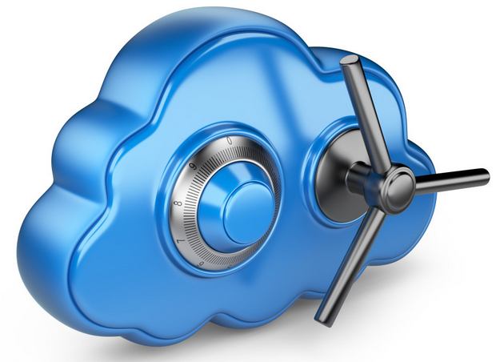
“0-management”: our Cloud Robot
Why
Existing frameworks got very complex e.g. OpenStack
Existing services are complex: Amazon, Google.
What
Text based very easy interface to cloud automation.
Multiple channels: email, chat, rest, textfile, …
Works on top of any cloud or physical server.
Strict versioning & change management.
100% logging & control.
Benefits
1/10 of management cost for deploying applications.
Less human errors.
Speed of deployment
Cost control

Slide 17

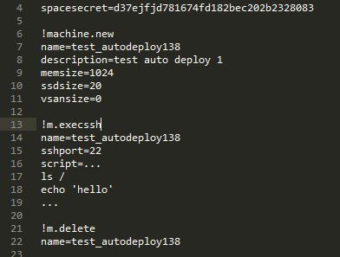
“0-management”: our Cloud Robot

Slide 18
“0-network”: privacy & transparency
Why
When building complex or larger cloud solutions network virtualization is a must.
Is not available when using on dedicated server
Is not available on many clouds.
What
Combination & orchestration of existing open source technologies like
OpenVSwich
VXLan
SSH Portforwarding
Benefits
Privacy even when used in global context.
Better Security.
Flexibility.

Slide 19
go2market
2014 (now)
Semi custom projects using our technology e.g. www.mothership1.com
2015
Cloud Brokerage & Wholesales Model (see next slide).
Cloud Robot as free service.
Continue with some semi custom projects.
2016
Get part of revenue stream on apps deployed through CR.
Certain features of CR get paying (e.g. replication, …)
Private Cloud Robot Instances.

Slide 20
Wholesale Model
Partner Dedicated
100% customizable
Portal / Catalog
Compute
& Storage
Boxes
DC1
Cloud Robot
Partner Dedicated
Cloud Backoffice System
(crm, tickets, chat,billing, invoicing, ...)
Compute
& Storage
Boxes
DC2
Partner up and running < weeks. 50%+ margin for platinum partners.
Partner can 100% define own products, look & feel, pricing, ...
Partner does not have to buy hardware or colocation space. We leverage players like Hetzner, OVH, …

Slide 21
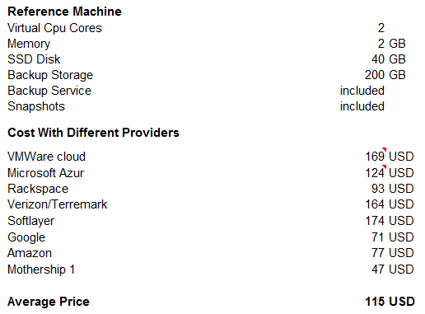
VM Reference Machine Price Comparison
Conclusion:
Pricing of clouds in general is very non transparant.
In the business case we took 50 USD for selling a VM, this is very reasonable compared with the others.
See excel for more info.

Slide 22


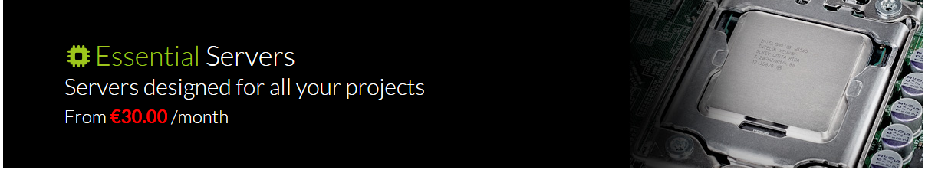
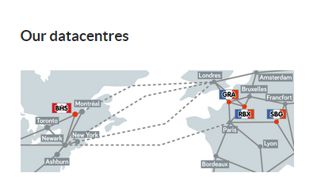
OVH Dedicated Server Price
40 EUR for a server which can run 15 vm’s of 2GB mem each.
Multiple Datacenters
+- Unlimited Bandwidth

Slide 23

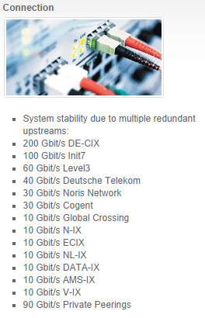
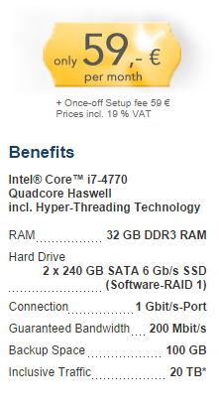
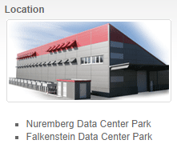
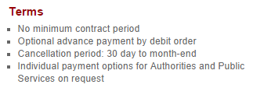
Hetzner Dedicated Server Price

Slide 24
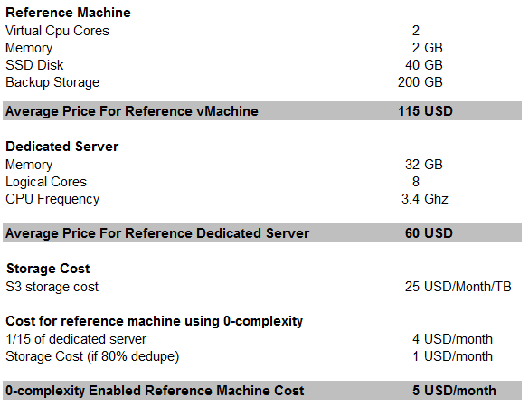
Cloud Unbalance
OVH = 40 EUR, Hetzner 50 EUR for 32 GB mem
0-complexity Technology upgrades these machines to become full blown cloud machine with unseen features & reliability levels.
20 times
cost savings

